Slide 1
SPRINT 03 · DELIVERABLE 04
AI Toolkit
Hub.
AI
A unified platform for translation, summarization, flashcards, voice translation, and text-to-speech.
THE TEAM
Aryan Patel · U01999176
Bansari Shah · U01983468
Lakshmi Prasanna · U01950459
Pratham Patel · U02002338
Vivek Pitroda · U01992349

Slide 2
01 · ROADMAP
Agenda
Where we're going in the next 30 minutes
01
Sprint scope and deliverables
02
Project overview
03
Team roles and working agreement
04
Professor feedback improvements
05
Sprint 2 recap and Sprint 3 backlog
06
Completed and incomplete work
07
Testing, metrics, and retrospective
08
Sprint 3 plan and project demo
KEY FEATURES
Translation
Summarization
PDF → Flashcards
Voice Translation
Text-to-Speech
AI TOOLKIT HUB · SPRINT 3
02 / 33

Slide 3
02 · CONTEXT
Problem Statement
Target users, pain points, and our solution hypothesis
WHO
WHAT
Students, educators, professionals
Tool fatigue and context loss
Multilingual users working with long texts, PDFs, and cross-language communication.
Time wasted switching between multiple tools for translation, summarizing, studying, and voice work.
WHY CURRENT SOLUTIONS FAIL
HYPOTHESIS
— Fragmented experience across 3–5 apps
A single AI Toolkit Hub for students and multilingual professionals will reduce tool-switching time and improve comprehension by combining language and study workflows in one place.
— Limited history and export options
— Voice translation doesn't pair with text records
AI TOOLKIT HUB · SPRINT 3
03 / 33

Slide 4
03 · PEOPLE
Team Roles & Responsibilities
Ownership across product, frontend, backend, AI/ML, and QA / DevOps
Product Owner
Requirements, user stories, backlog priority, sprint planning
Aryan Patel
Frontend Lead
React.js UI, Tailwind CSS, API integration, flashcard UI
Bansari Shah
Backend Lead
Node.js APIs, JWT authentication, database, endpoints
Pratham Patel
AI / ML Lead
AI API integration, prompt design, PDF→flashcard logic
Vivek Pitroda
QA / DevOps
Testing, GitHub workflow, deployment, documentation
Lakshmi Prasanna
AI TOOLKIT HUB · SPRINT 3
04 / 33

Slide 5
04 · OPERATING MODEL
Team Working Agreement
Communication norms, meetings, and accountability
COMMUNICATION
MEETINGS
· Google Meet, WhatsApp, Notion
· 24-hour response time
· Early notice when unavailable
· Saturday 4–5 PM (Virtual)
· Monday 9–10 PM (Virtual)
· Wednesday 4:30–5:30 PM (In-person)
WORK EXPECTATIONS
ACCOUNTABILITY & QUALITY
· Complete tasks by deadline
· Reach out early if blocked
· Fair workload distribution
· Supportive accountability
· Open about missed deadlines
· Review work before submission
AI TOOLKIT HUB · SPRINT 3
05 / 33

Slide 6
05 · ITERATION
Improvements from Professor Feedback
Direct response to last sprint's review
01
02
03
Re-scoped MVP
Sprint recap added
Aligned artifacts
Now includes usable product features — not authentication alone.
Clear Sprint 2 recap and Sprint 3 summary sections introduced.
Backlog, test cases, and metrics are aligned with the current sprint.
AI TOOLKIT HUB · SPRINT 3
06 / 33

Slide 7
06 · PERSONA 1
Liam Chen
Language Learner / Accessibility User
GOALS
HOW AI TOOLKIT HELPS
LC
· Practice real-time conversations via voice translation
· Generate audio from text content
· Improve language comprehension
· Live voice translation supports conversation practice
· Text-to-speech improves accessibility
· Translator supports multilingual learning
Liam Chen
Language Learner / Accessibility User
FRUSTRATIONS
No real-time support in many apps · Too many separate tools
AI TOOLKIT HUB · SPRINT 3
07 / 33

Slide 8
06 · PERSONA 2
Daniel Carter
Busy Professional
GOALS
HOW AI TOOLKIT HELPS
DC
· Translate client communication quickly
· Summarize long reports into key points
· Listen to content while multitasking
· Translator speeds communication
· Summarizer extracts main insights
· Text-to-speech supports multitasking
Daniel Carter
Busy Professional
FRUSTRATIONS
Reading long reports is time-consuming · Using multiple tools slows work
AI TOOLKIT HUB · SPRINT 3
08 / 33

Slide 9
06 · PERSONA 3
Maria Gonzalez
International Student
GOALS
HOW AI TOOLKIT HELPS
MG
· Translate academic material quickly
· Summarize long articles for study
· Convert PDFs into flashcards
· Translation helps understand course material
· Summaries reduce reading time
· PDF-to-flashcards creates study support
Maria Gonzalez
International Student
FRUSTRATIONS
Complex English content is difficult · Manual study-note creation takes time
AI TOOLKIT HUB · SPRINT 3
09 / 33

Slide 10
07 · SCOPE
Minimum Viable Product
The smallest usable version of AI Toolkit Hub for Sprint 3
Authenticated users can interact with the product through voice-based features inside a single, unified application.
01
02
03
User registration & login
Complete UI flow
Backend API integration
04
05
06
Voice translation feature
Base dashboard / navigation
Text-to-Speech (TTS)
AI TOOLKIT HUB · SPRINT 3
10 / 33

Slide 11
08 · STACK
Technologies
Frontend, backend, AI services, and database
FRONTEND
BACKEND
React.js · Tailwind CSS · Axios · react-card-flip · Framer Motion
Node.js + Express · Multer (uploads) · pdf-parse · JWT + bcrypt
AI SERVICES
DATABASE
MyMemory Translation API · Hugging Face (BART, FLAN-T5) · Web Speech API
MongoDB
AI TOOLKIT HUB · SPRINT 3
11 / 33

Slide 12
09 · UNDER THE HOOD
Algorithms & Processing
How each feature is powered
Text Translation
Text Summarization
1
MyMemory API + rule-based handling
2
facebook/bart-large-cnn
Input validation, language mapping, history logging
Length control, formatting, response cleanup
PDF → Flashcards
Live Voice Translation
3
google/flan-t5-large + pdf-parse
4
SpeechRecognition → Translate → Synth
Extraction, chunking, Q&A generation, JSON formatting
Real-time transcription, API chaining, fallback
Text-to-Speech
Authentication
5
Web Speech API
6
JWT + bcrypt
Voice selection, pitch / rate control, playback
Password hashing, token gen, middleware verification
AI TOOLKIT HUB · SPRINT 3
12 / 33

Slide 13
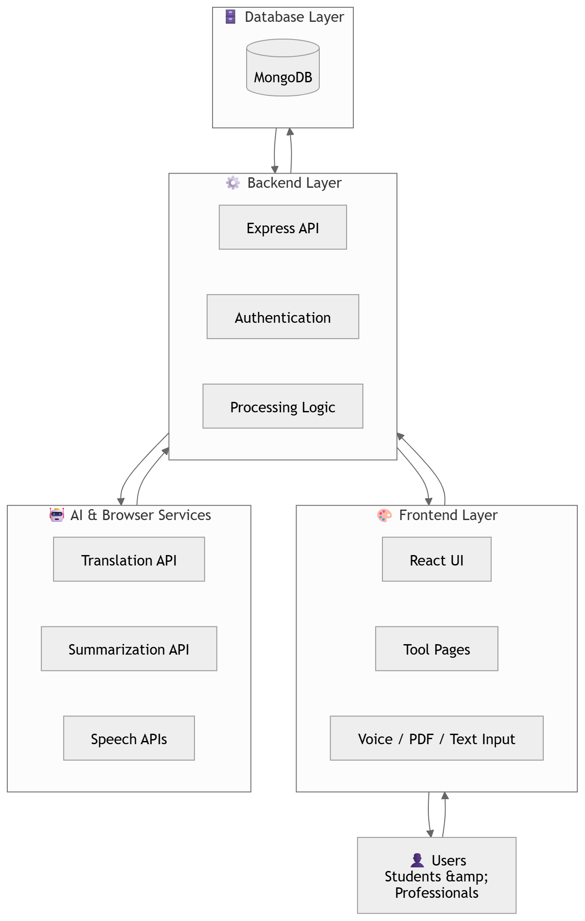
10 · ARCHITECTURE
System Architecture
Updated architecture diagram
AI TOOLKIT HUB · SPRINT 3
13 / 33

Slide 14
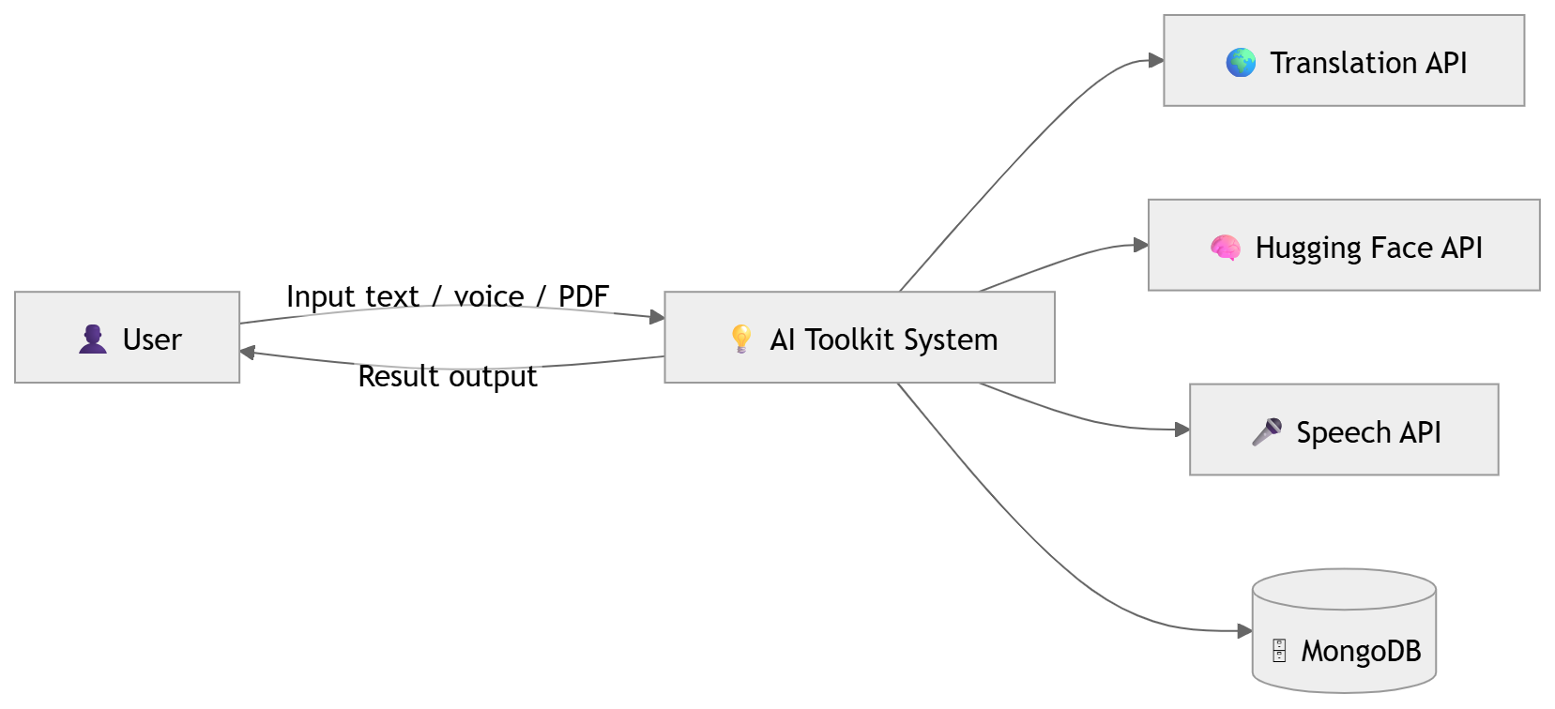
11 · ARCHITECTURE
Context Diagram
High-level system context with users and services
AI TOOLKIT HUB · SPRINT 3
14 / 33

Slide 15
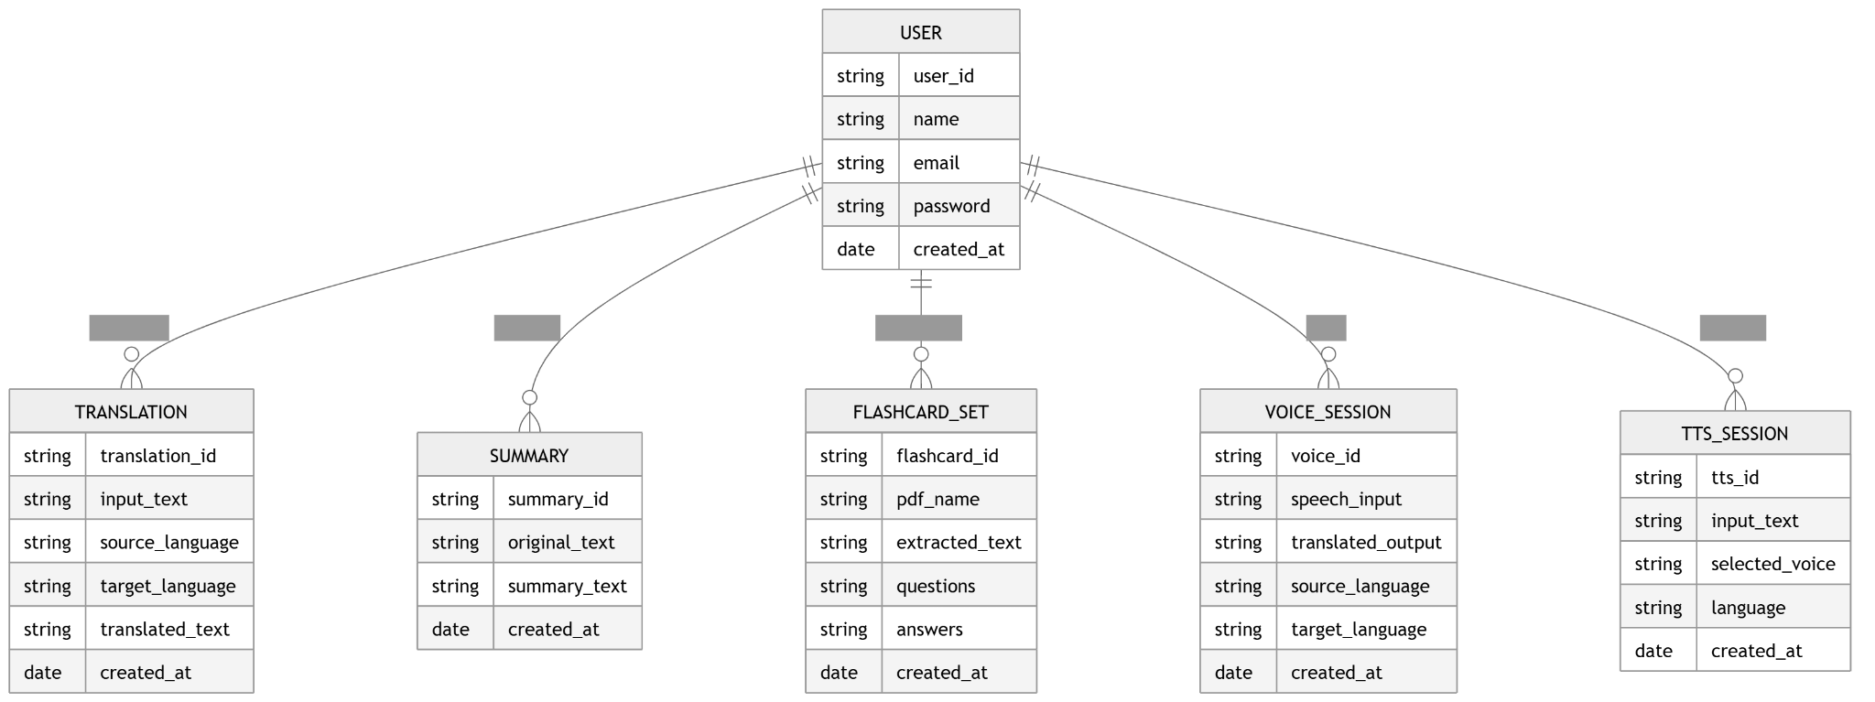
12 · ARCHITECTURE
ER Diagram
Updated database design and entity relationships
AI TOOLKIT HUB · SPRINT 3
15 / 33

Slide 16
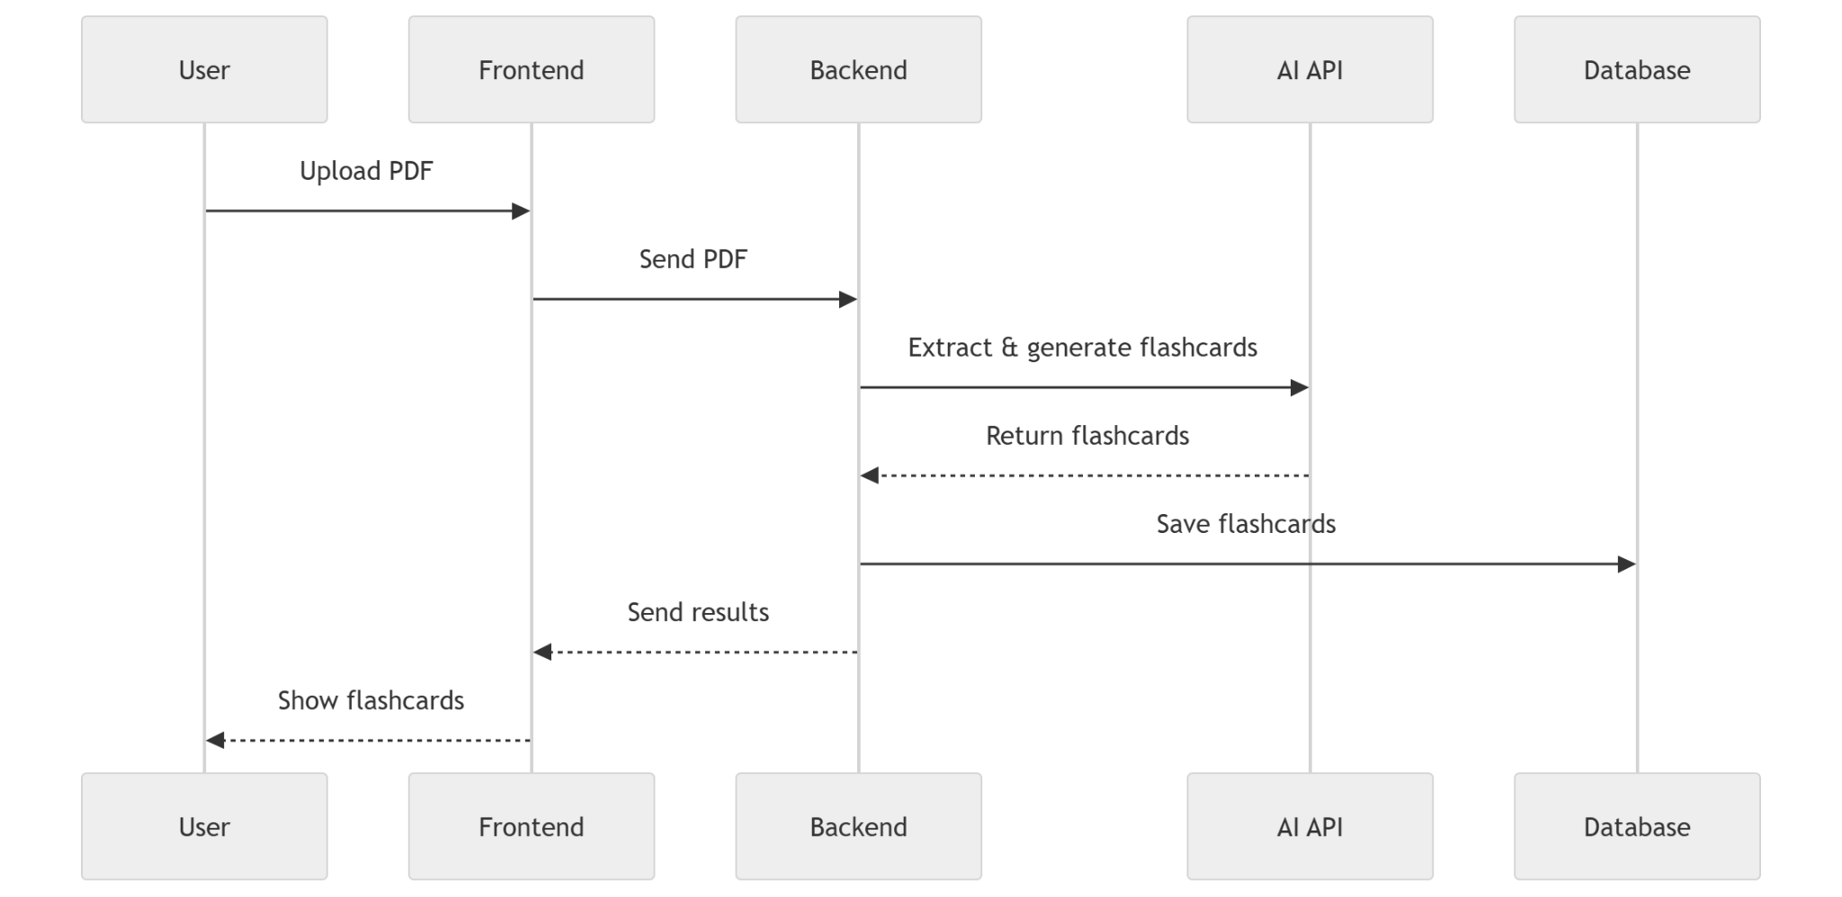
13 · ARCHITECTURE
Sequence Diagram
Interaction flow for the PDF-to-flashcards feature
AI TOOLKIT HUB · SPRINT 3
16 / 33

Slide 17
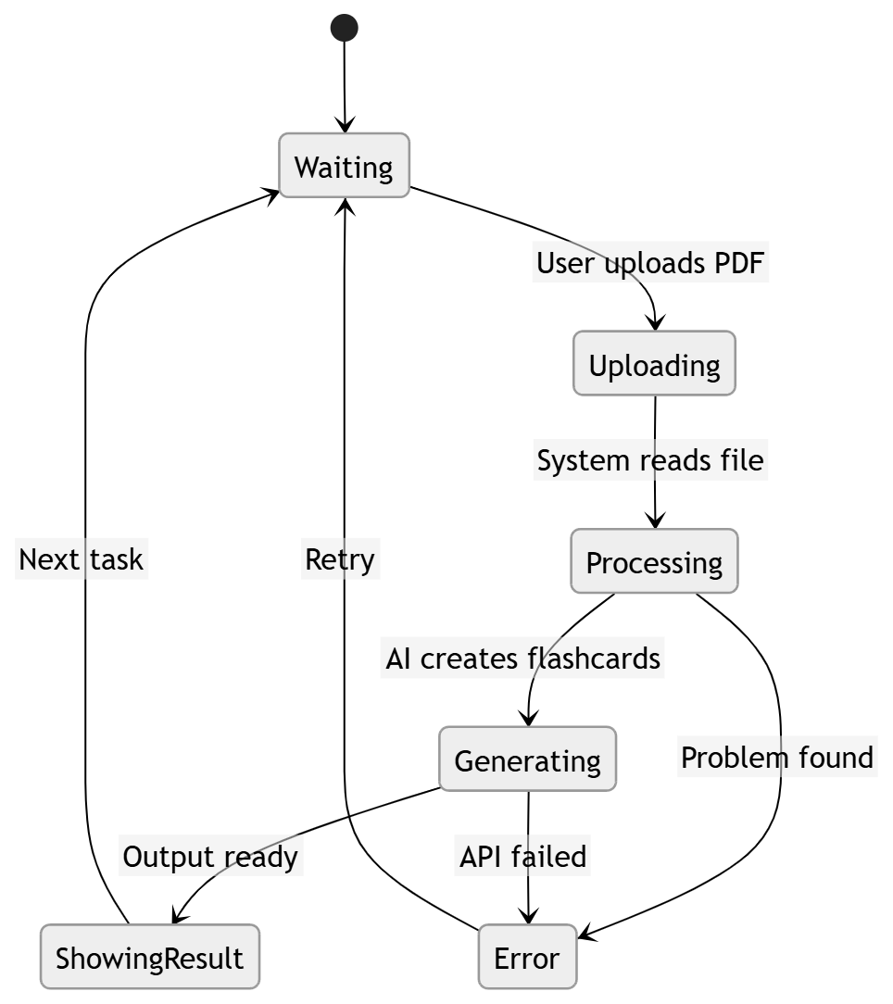
14 · ARCHITECTURE
State Diagram
State transitions for flashcard generation
AI TOOLKIT HUB · SPRINT 3
17 / 33

Slide 18
15 · RECAP
Sprint 2 → Sprint 3
What we built on, and where we took it
WHAT SPRINT 2 ESTABLISHED
HOW SPRINT 3 BUILDS ON IT
· Authentication foundation — login + registration
· Dashboard structure and MongoDB connection
· Initial API testing using Postman
· Base architecture and diagrams prepared
· Transitioned UI toward an interactive, voice-enabled experience
· Real-time voice translation across multiple languages
· Text-to-Speech (TTS) for dynamic audio responses
· Speech-to-Text (STT) for seamless voice input
· Shifted focus from setup to intelligent, user-centric features
AI TOOLKIT HUB · SPRINT 3
18 / 33

Slide 19
16 · RECAP
Sprint Journey
Four deliverables, one product
DELIVERABLE 1
DELIVERABLE 2
DELIVERABLE 3
DELIVERABLE 4
Sprint 0 — Foundation
Sprint 1 — Progress
Sprint 2 — Progress
Sprint 3 — Current
Planning, architecture, auth setup, dashboard basics
Improved flows, diagrams, feedback updates, core integration
UI completed, all APIs completed, flashcard generation done
UI complete, all APIs complete, voice translation, TTS done
AI TOOLKIT HUB · SPRINT 3
19 / 33

Slide 20
17 · PLAN
Sprint 3 Backlog
Committed work for the current sprint
ID
STORY / TASK
STATUS
S3-01
Complete application UI across main screens
DONE
S3-02
Finish all backend APIs and integrations
DONE
S3-03
Implement voice translation functionality
DONE
S3-04
Integrate Text-to-Speech (TTS) for audio output
DONE
S3-05
Build profile page UI
DONE
AI TOOLKIT HUB · SPRINT 3
20 / 33

Slide 21
18 · DELIVERY
User Stories — Overview
Completed stories and carryover
COMPLETED
· Fully functional UI — seamless navigation across core screens
· Backend APIs fully integrated and validated
· Real-time voice translation enabling multi-language communication
· Secure authentication and profile management implemented
· Text-to-Speech (TTS) delivering dynamic audio responses
100%
Sprint 3 delivery
No carryover items
AI TOOLKIT HUB · SPRINT 3
21 / 33

Slide 22
19 · STORIES
User Stories & Acceptance
Authentication and Voice Translation
US-1
US-2
Authentication Access
Voice Translation
As a user, I want to register and log in securely so that I can access the AI Toolkit Hub and my personalized workspace.
As a user, I want to translate spoken or typed input into another language so I can communicate easily.
ACCEPTANCE
ACCEPTANCE
✓ Account creation with required fields
✓ Login with valid credentials
✓ Invalid credentials show an error
✓ Protected screens require auth
✓ Voice or text input accepted
✓ Speech-to-Text converts accurately
✓ Translated output in selected language
✓ Multiple languages supported
AI TOOLKIT HUB · SPRINT 3
22 / 33

Slide 23
20 · STORIES
User Stories & Acceptance
Text-to-Speech and Product UI
US-3
US-4
Text-to-Speech
Complete Product UI
As a user, I want to hear translated or input text as audio so I can understand pronunciation and improve accessibility.
As a user, I want a clean, navigable interface so I can easily use all voice features.
ACCEPTANCE
ACCEPTANCE
✓ Clear audio output from text
✓ Smooth, responsive playback
✓ Multiple languages and voices
✓ Works on translated and original text
✓ Main screens load correctly
✓ Smooth navigation across features
✓ Clean, usable release demo
✓ Visually complete for presentation
AI TOOLKIT HUB · SPRINT 3
23 / 33

Slide 24
21 · QA
Sprint 3 Test Cases
Coverage across authentication, navigation, integration, and voice
ID
AREA
TEST ACTION
EXPECTED
STATUS
TC-01
Authentication
Register with valid user data
Account created successfully
✓
TC-02
Authentication
Login with registered credentials
User redirected into app
✓
TC-03
UI Navigation
Navigate across core app screens
Seamless navigation, no errors
✓
TC-04
API Integration
Trigger backend APIs via frontend
Accurate, timely responses
✓
TC-05
Voice Translation
Input voice / text and translate
Real-time, multi-language result
✓
TC-06
Text-to-Speech
Generate audio from input / translated text
Clear, responsive audio output
✓
AI TOOLKIT HUB · SPRINT 3
24 / 33

Slide 25
22 · QA
Completed in Sprint 3
Everything we shipped this sprint
✓
UI Complete
✓
All APIs Complete
All main screens delivered with polish and consistency
Backend endpoints integrated and validated end-to-end
✓
Flashcard Generation
✓
Auth: Login & Register
PDF → flashcards working through FLAN-T5 pipeline
Secure JWT-based authentication flow stable
AI TOOLKIT HUB · SPRINT 3
25 / 33

Slide 26
23 · METRICS
Sprint 3 Metrics
Best-effort using current task count
6
6
100%
COMMITTED TASKS
COMPLETED TASKS
COMPLETED / COMMITTED
DELIVERED
UI · APIs · Voice Translation · TTS · Auth · Profile
AI TOOLKIT HUB · SPRINT 3
26 / 33

Slide 27
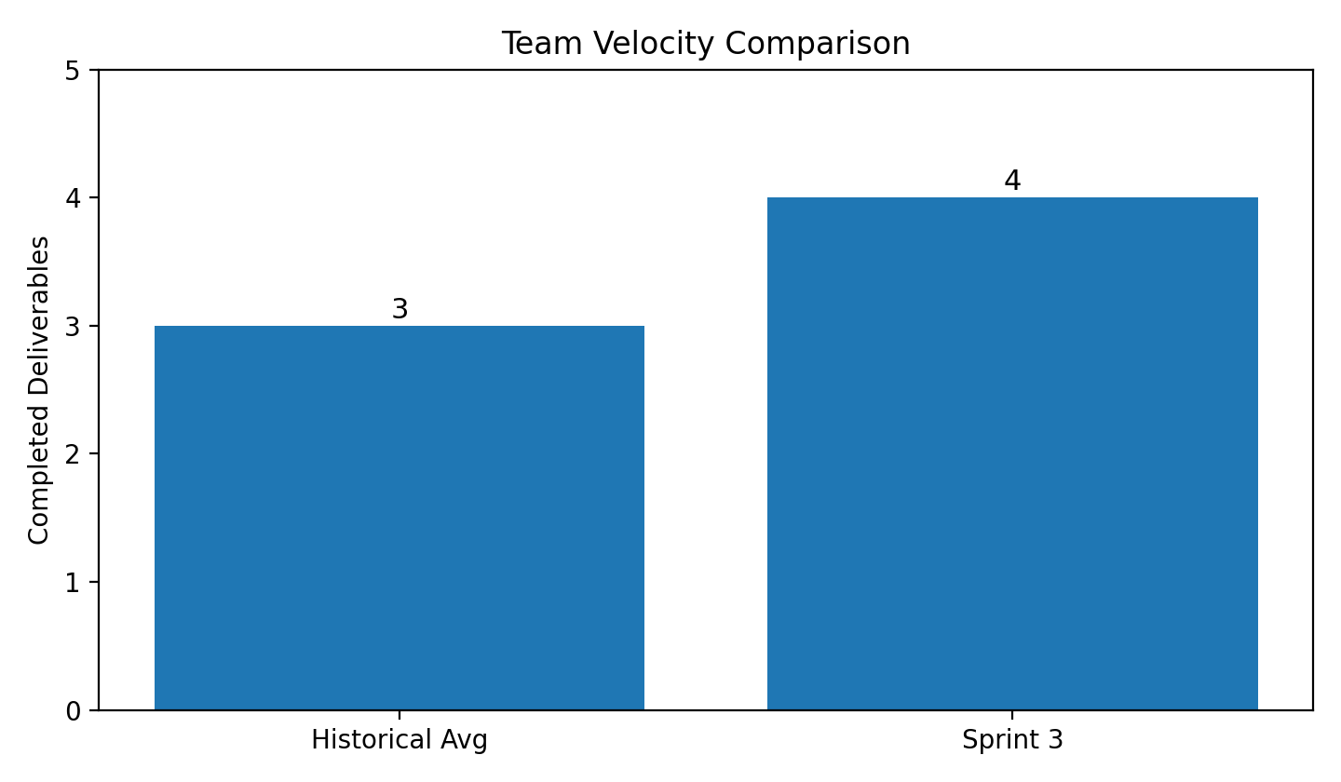
24 · METRICS
Team Velocity
This sprint vs. historical average
THIS SPRINT
6
completed deliverables
HISTORICAL AVG
3 deliverables / sprint
AI TOOLKIT HUB · SPRINT 3
27 / 33

Slide 28
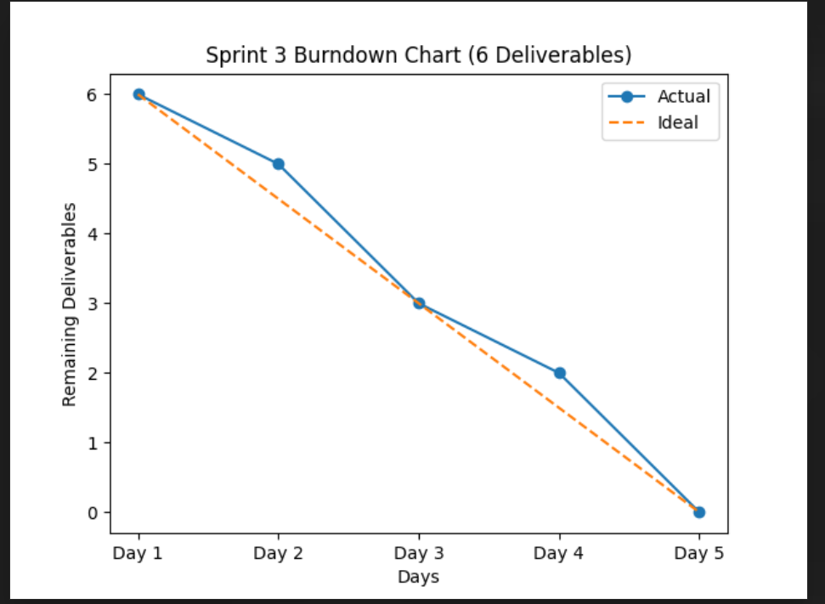
25 · METRICS
Burndown Chart
Tasks remaining over the sprint
AI TOOLKIT HUB · SPRINT 3
28 / 33

Slide 29
26 · REFLECTION
Sprint Retrospective
What went well and what to improve
WHAT WENT WELL
WHAT TO IMPROVE NEXT
✓ Main UI implementation completed successfully
✓ All APIs fully integrated and working
✓ Voice translation implemented successfully
✓ Text-to-Speech with smooth audio output
✓ Core authentication and profile are stable
→ No major improvements identified — sprint executed as planned
→ Continue maintaining code quality and performance standards
→ Explore enhancements and new feature opportunities next sprint
AI TOOLKIT HUB · SPRINT 3
29 / 33

Slide 30
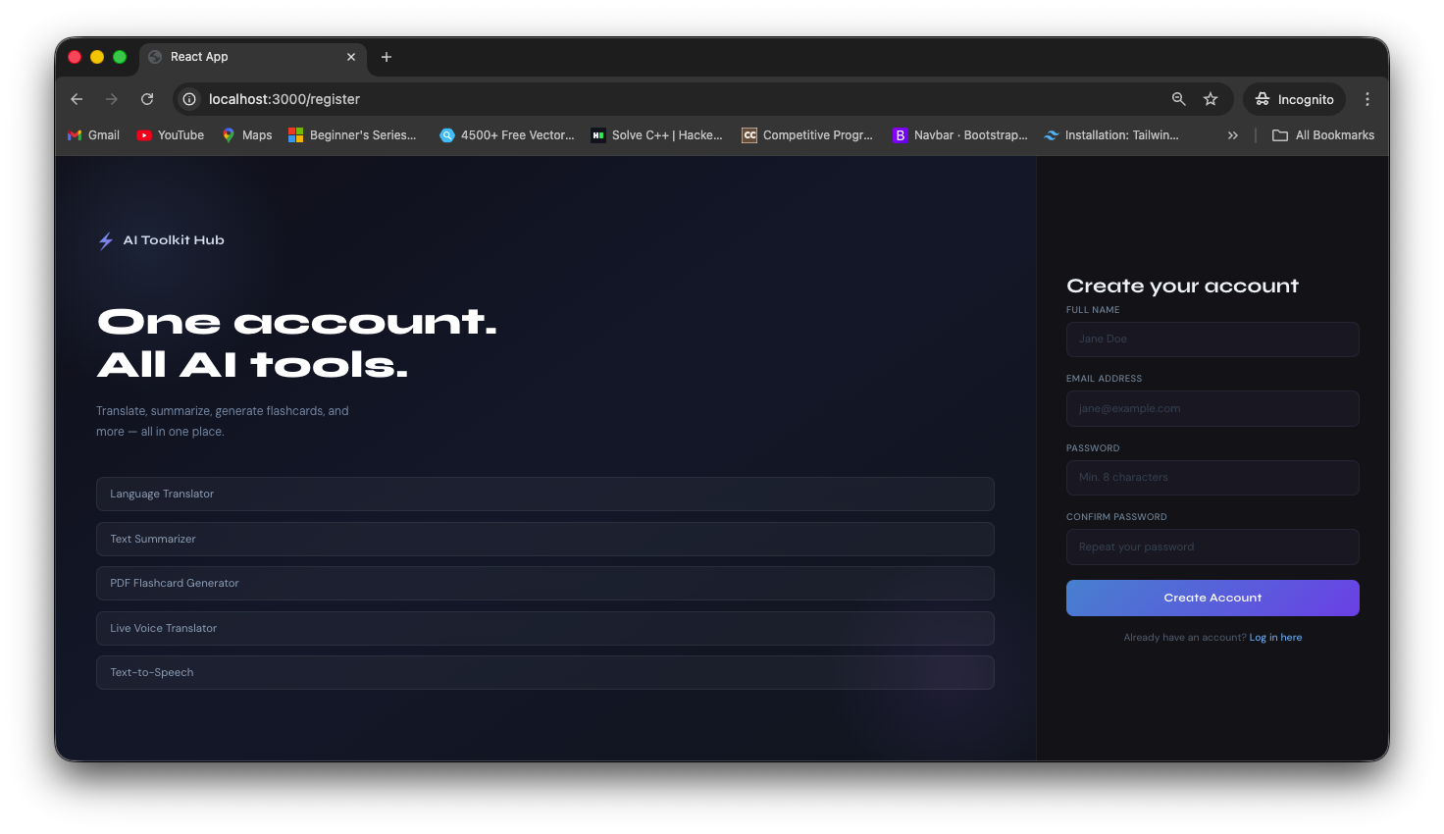
27 · DEMO
Project Demo
Authentication entry point — modern React UI
AI TOOLKIT HUB · SPRINT 3
30 / 33

Slide 31
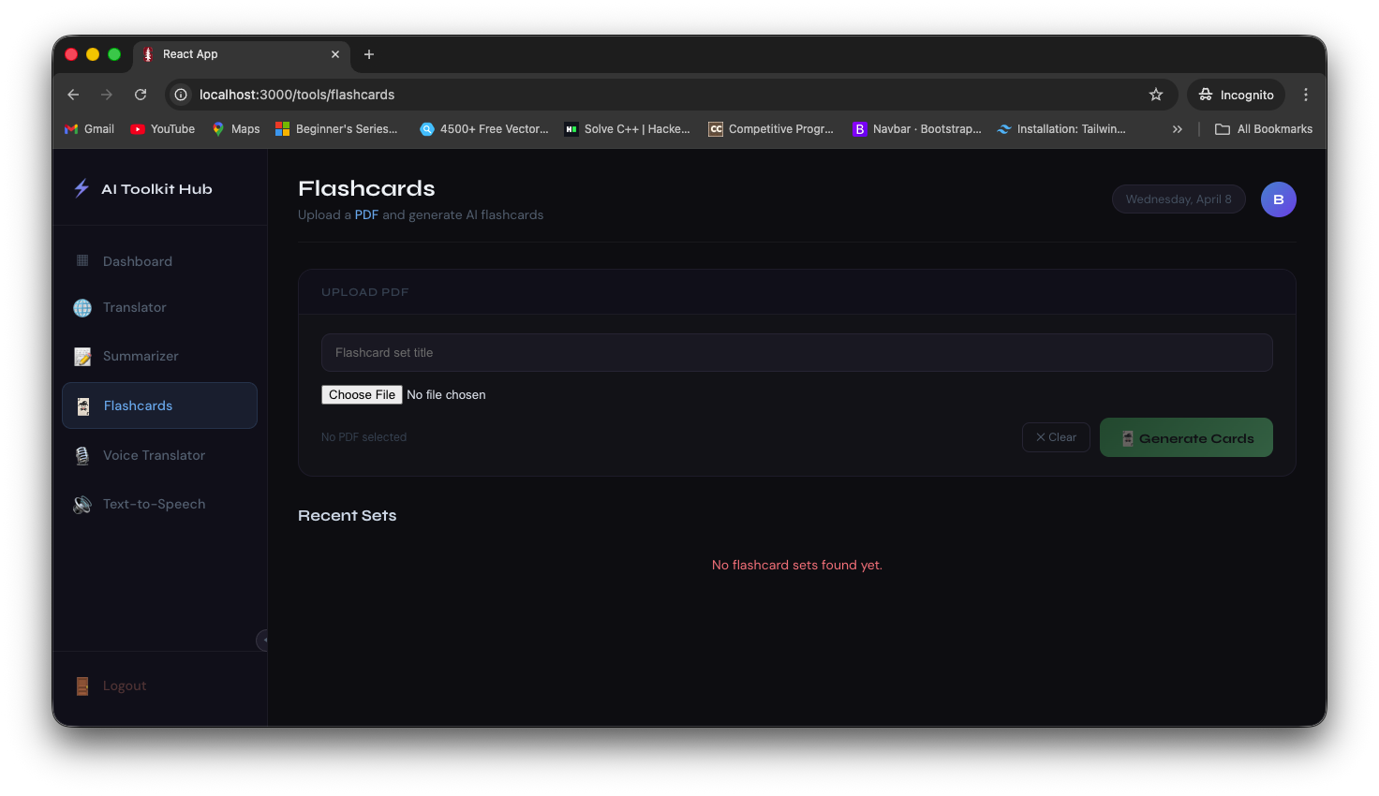
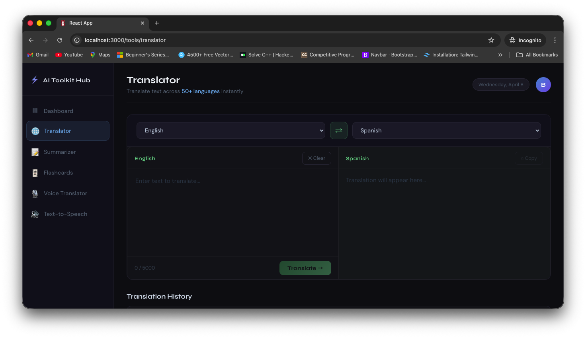
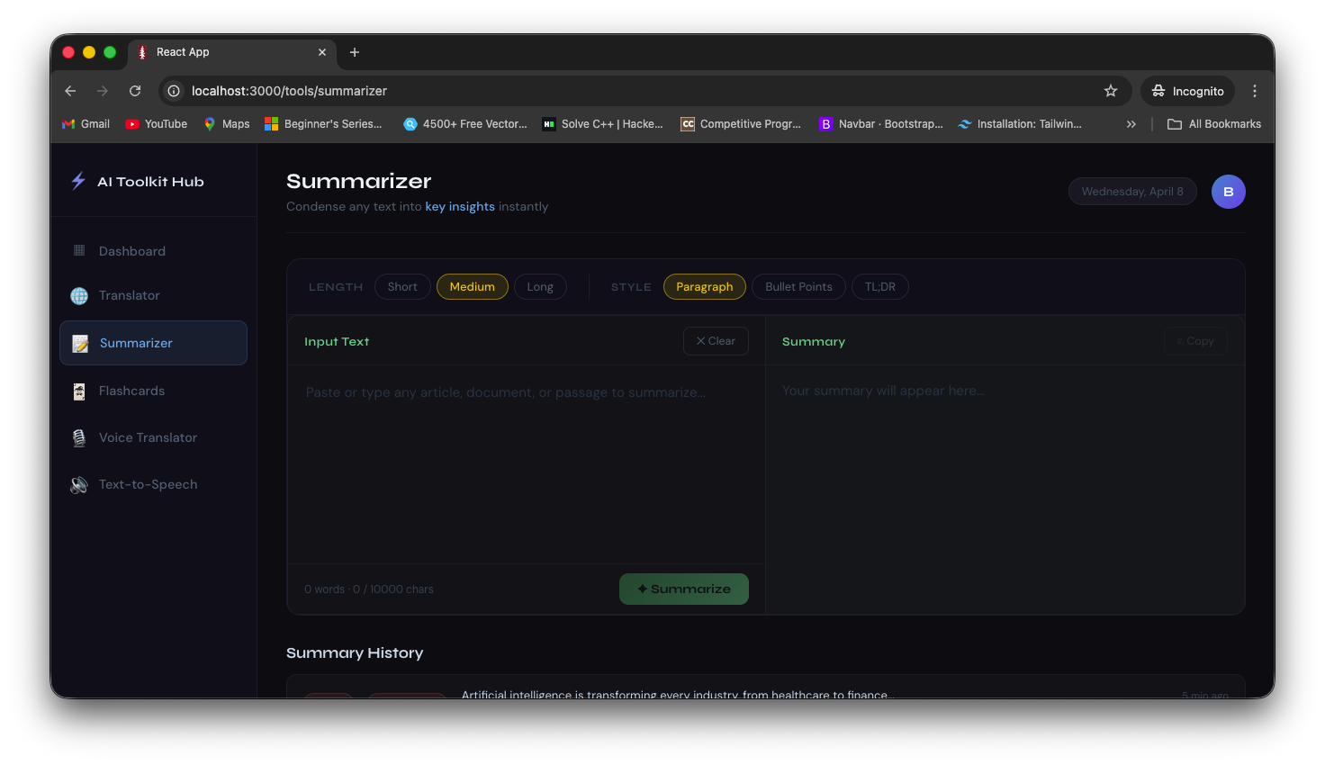
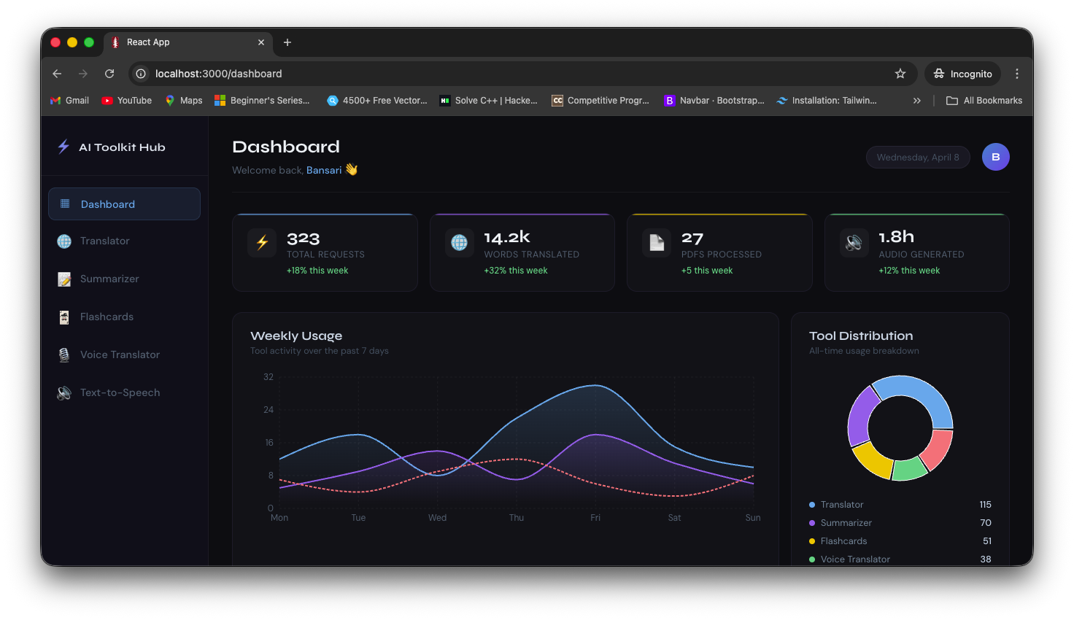
28 · DEMO
Inside the Product
Core screens across the application
AI TOOLKIT HUB · SPRINT 3
31 / 33

Slide 32
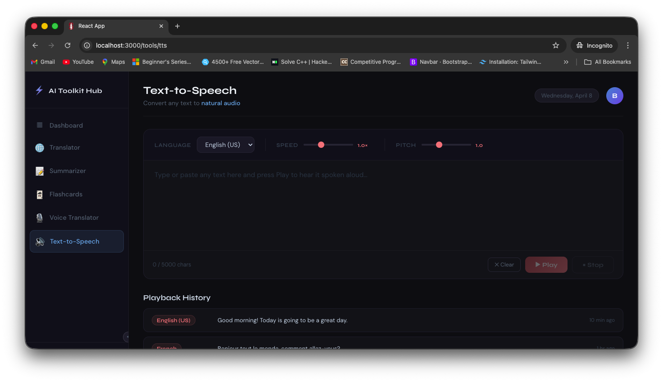
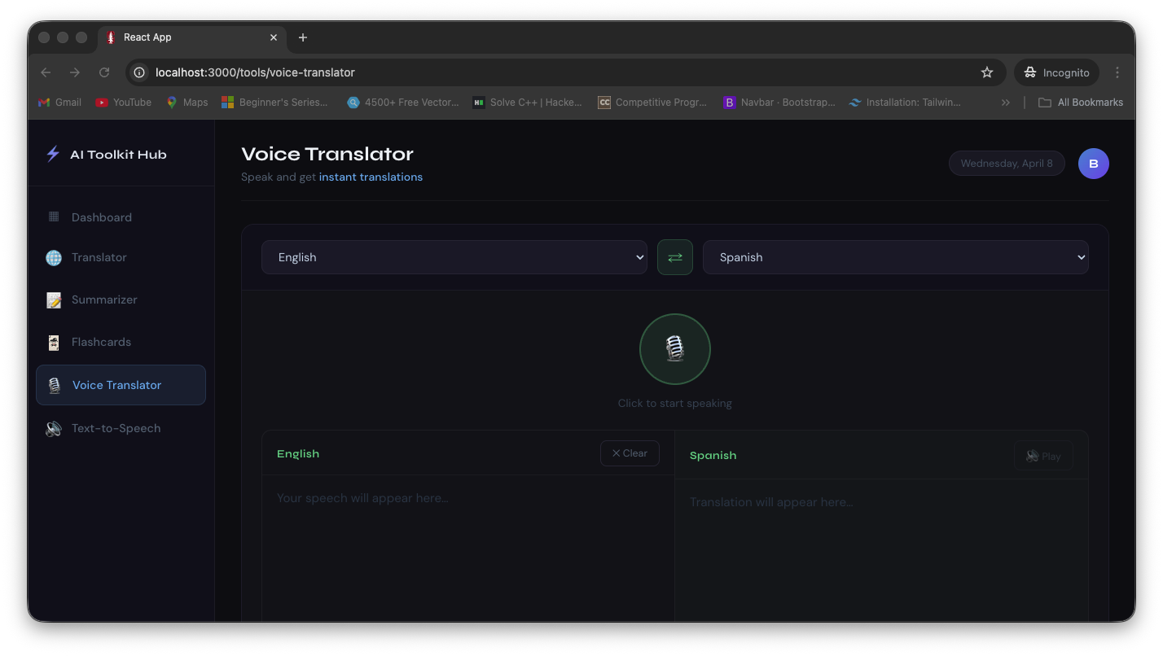
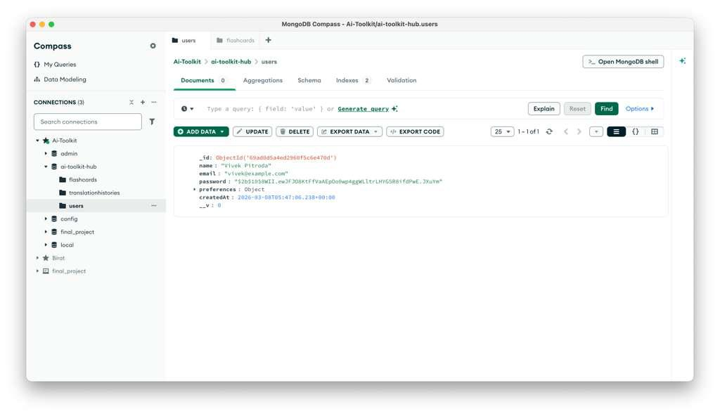
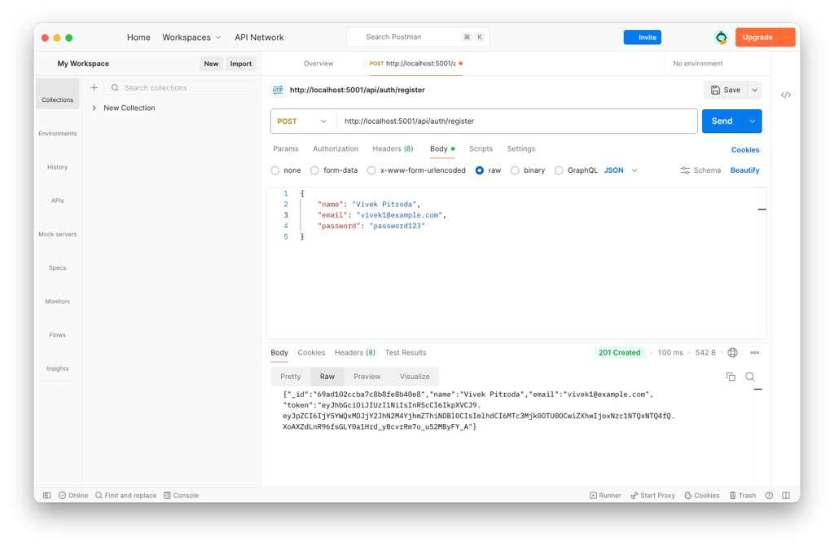
29 · DEMO
Voice & Translation in Action
Live voice features and translation flows
AI TOOLKIT HUB · SPRINT 3
32 / 33

Slide 33
Q & A · END OF DELIVERABLE 4
Thank you.
AI Toolkit Hub — Sprint 3 Presentation
AI
Aryan · Bansari · Lakshmi · Pratham · Vivek

